Slide 1
Second annual Pre-midterm championship
Bee2038: Intermediate Microeconomics

Slide 2
Turningpoint
You need to install App
Enter your ‘Name’ or nickname (for later glory)
Session ID: microecon

Slide 3
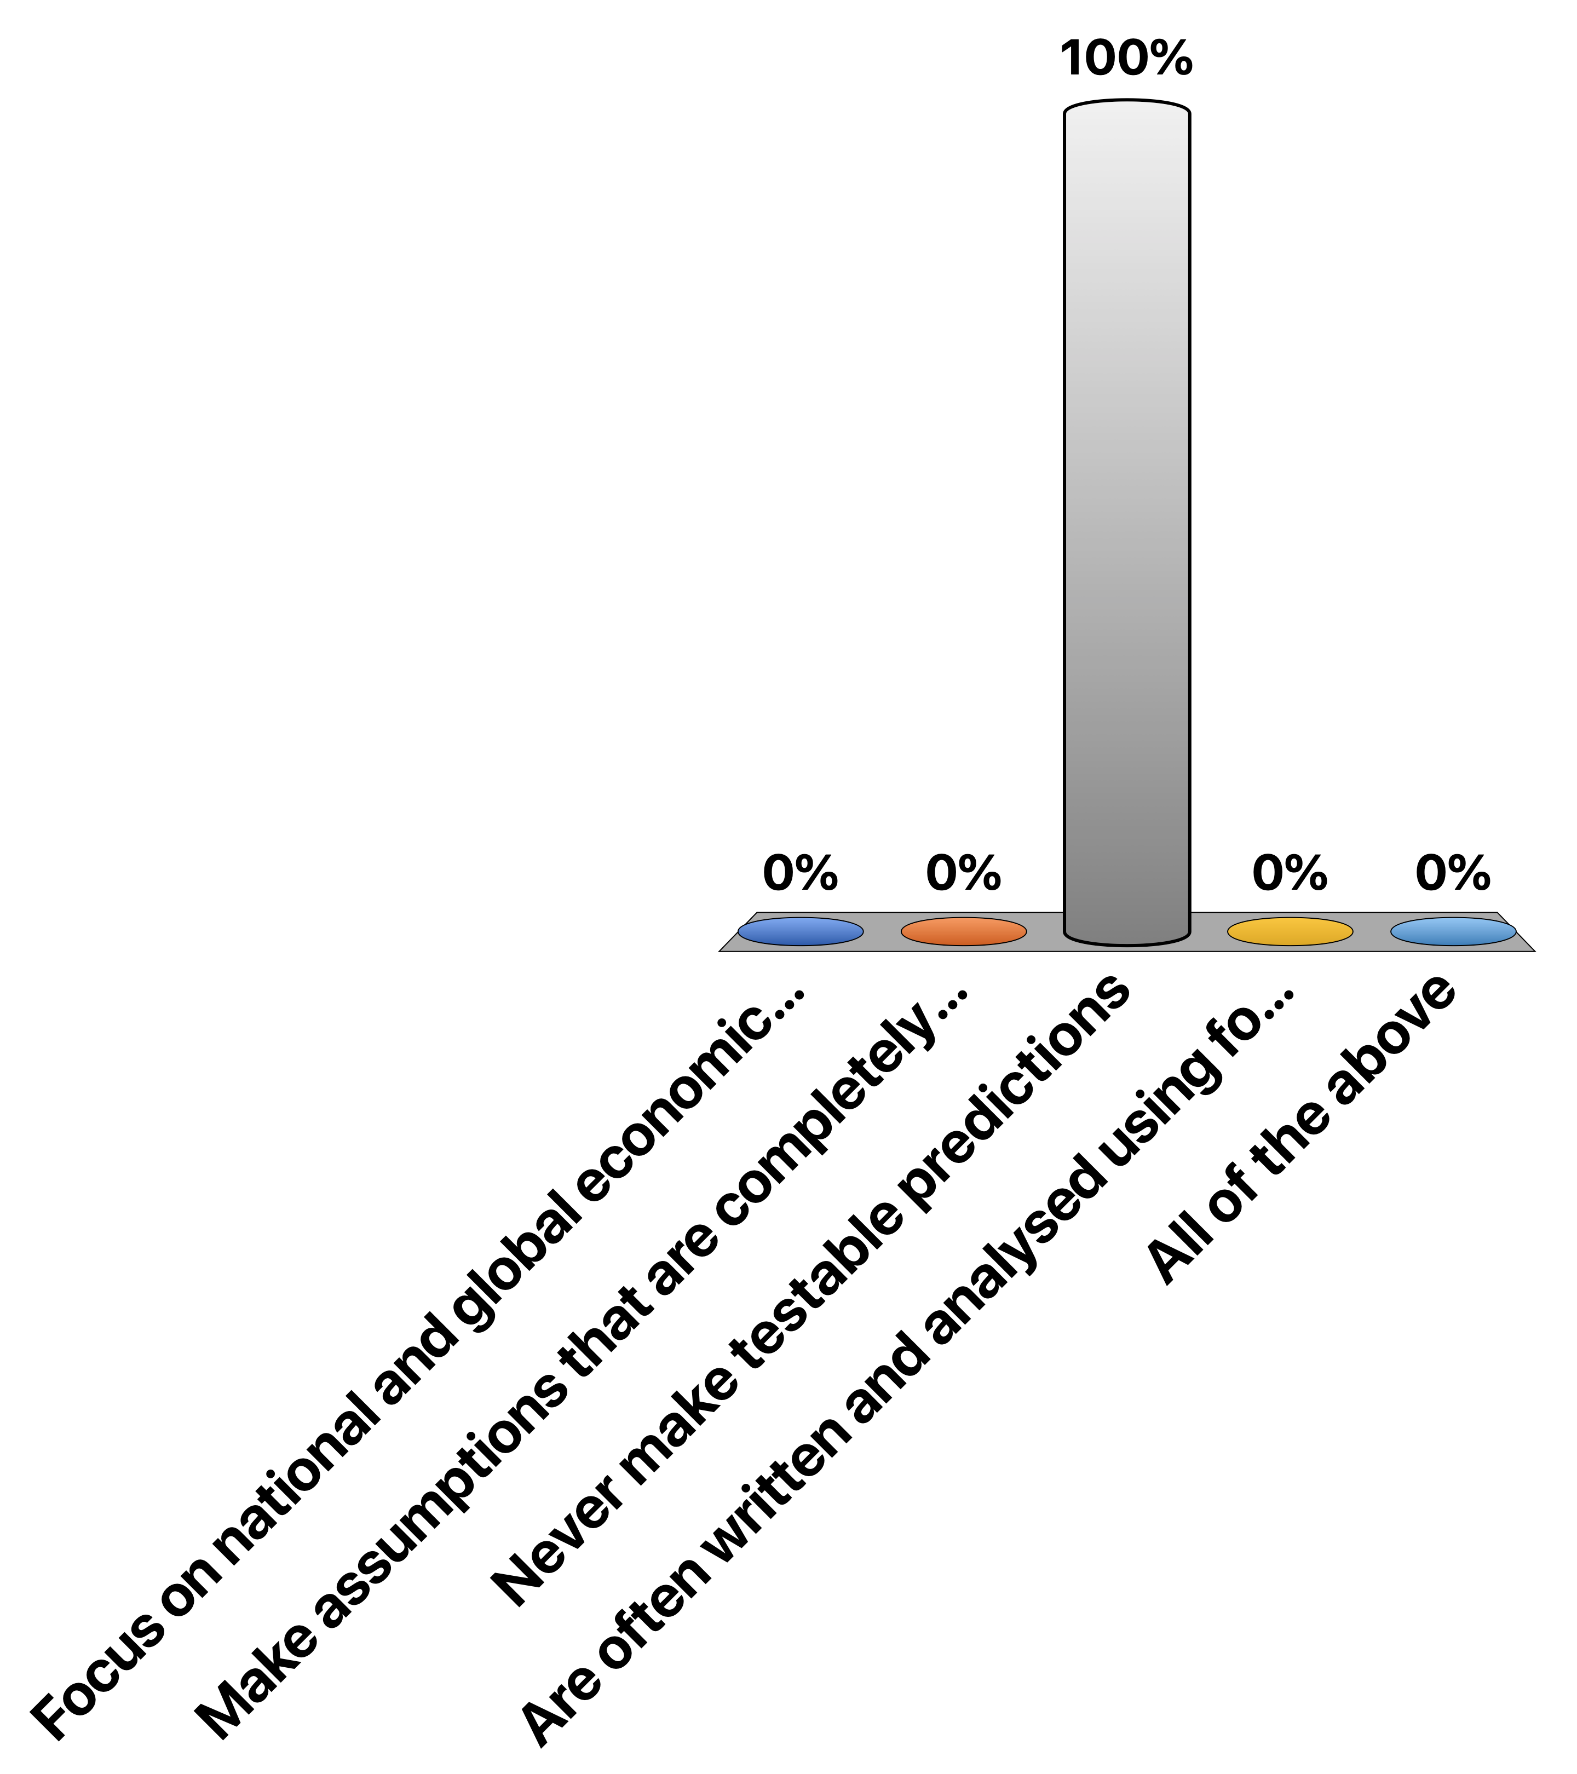
Microeconomic models… (choose one)
Make assumptions that are completely accurate and fully describe the real world
Focus on national and global economic growth and how this is affected by government borrowing and lending
Never make testable predictions
Are often written and analysed using formal mathematics
All of the above
:40

Slide 4
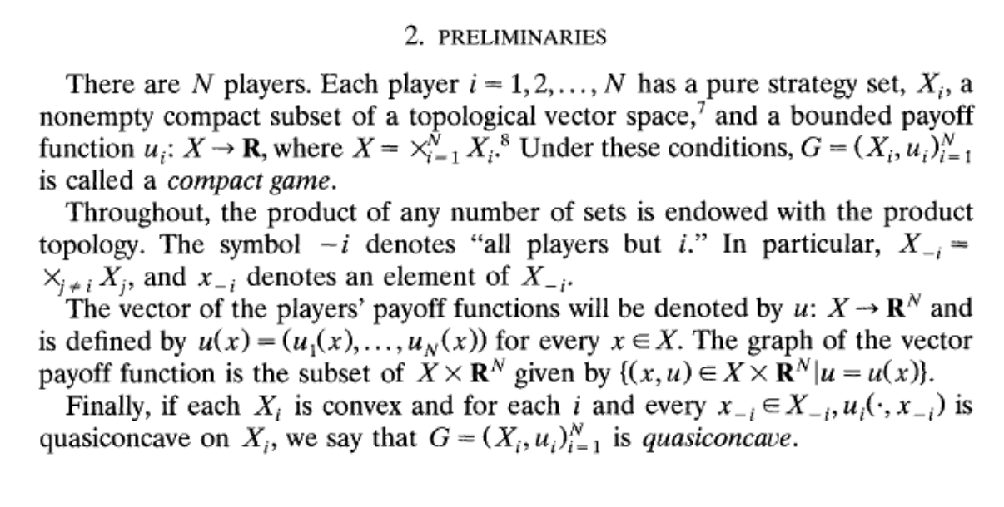
From “On the Existence of Pure and Mixed Strategy Nash Equilibria in Discontinuous Games”, Reny 1999

Slide 5
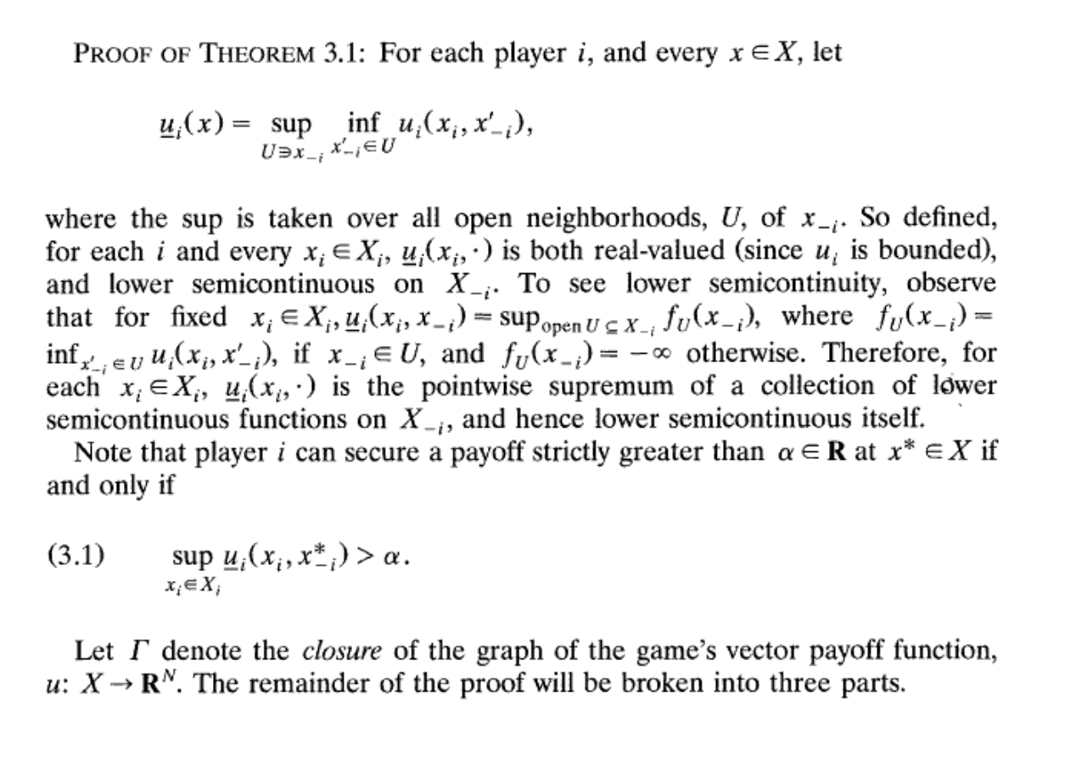

Slide 6
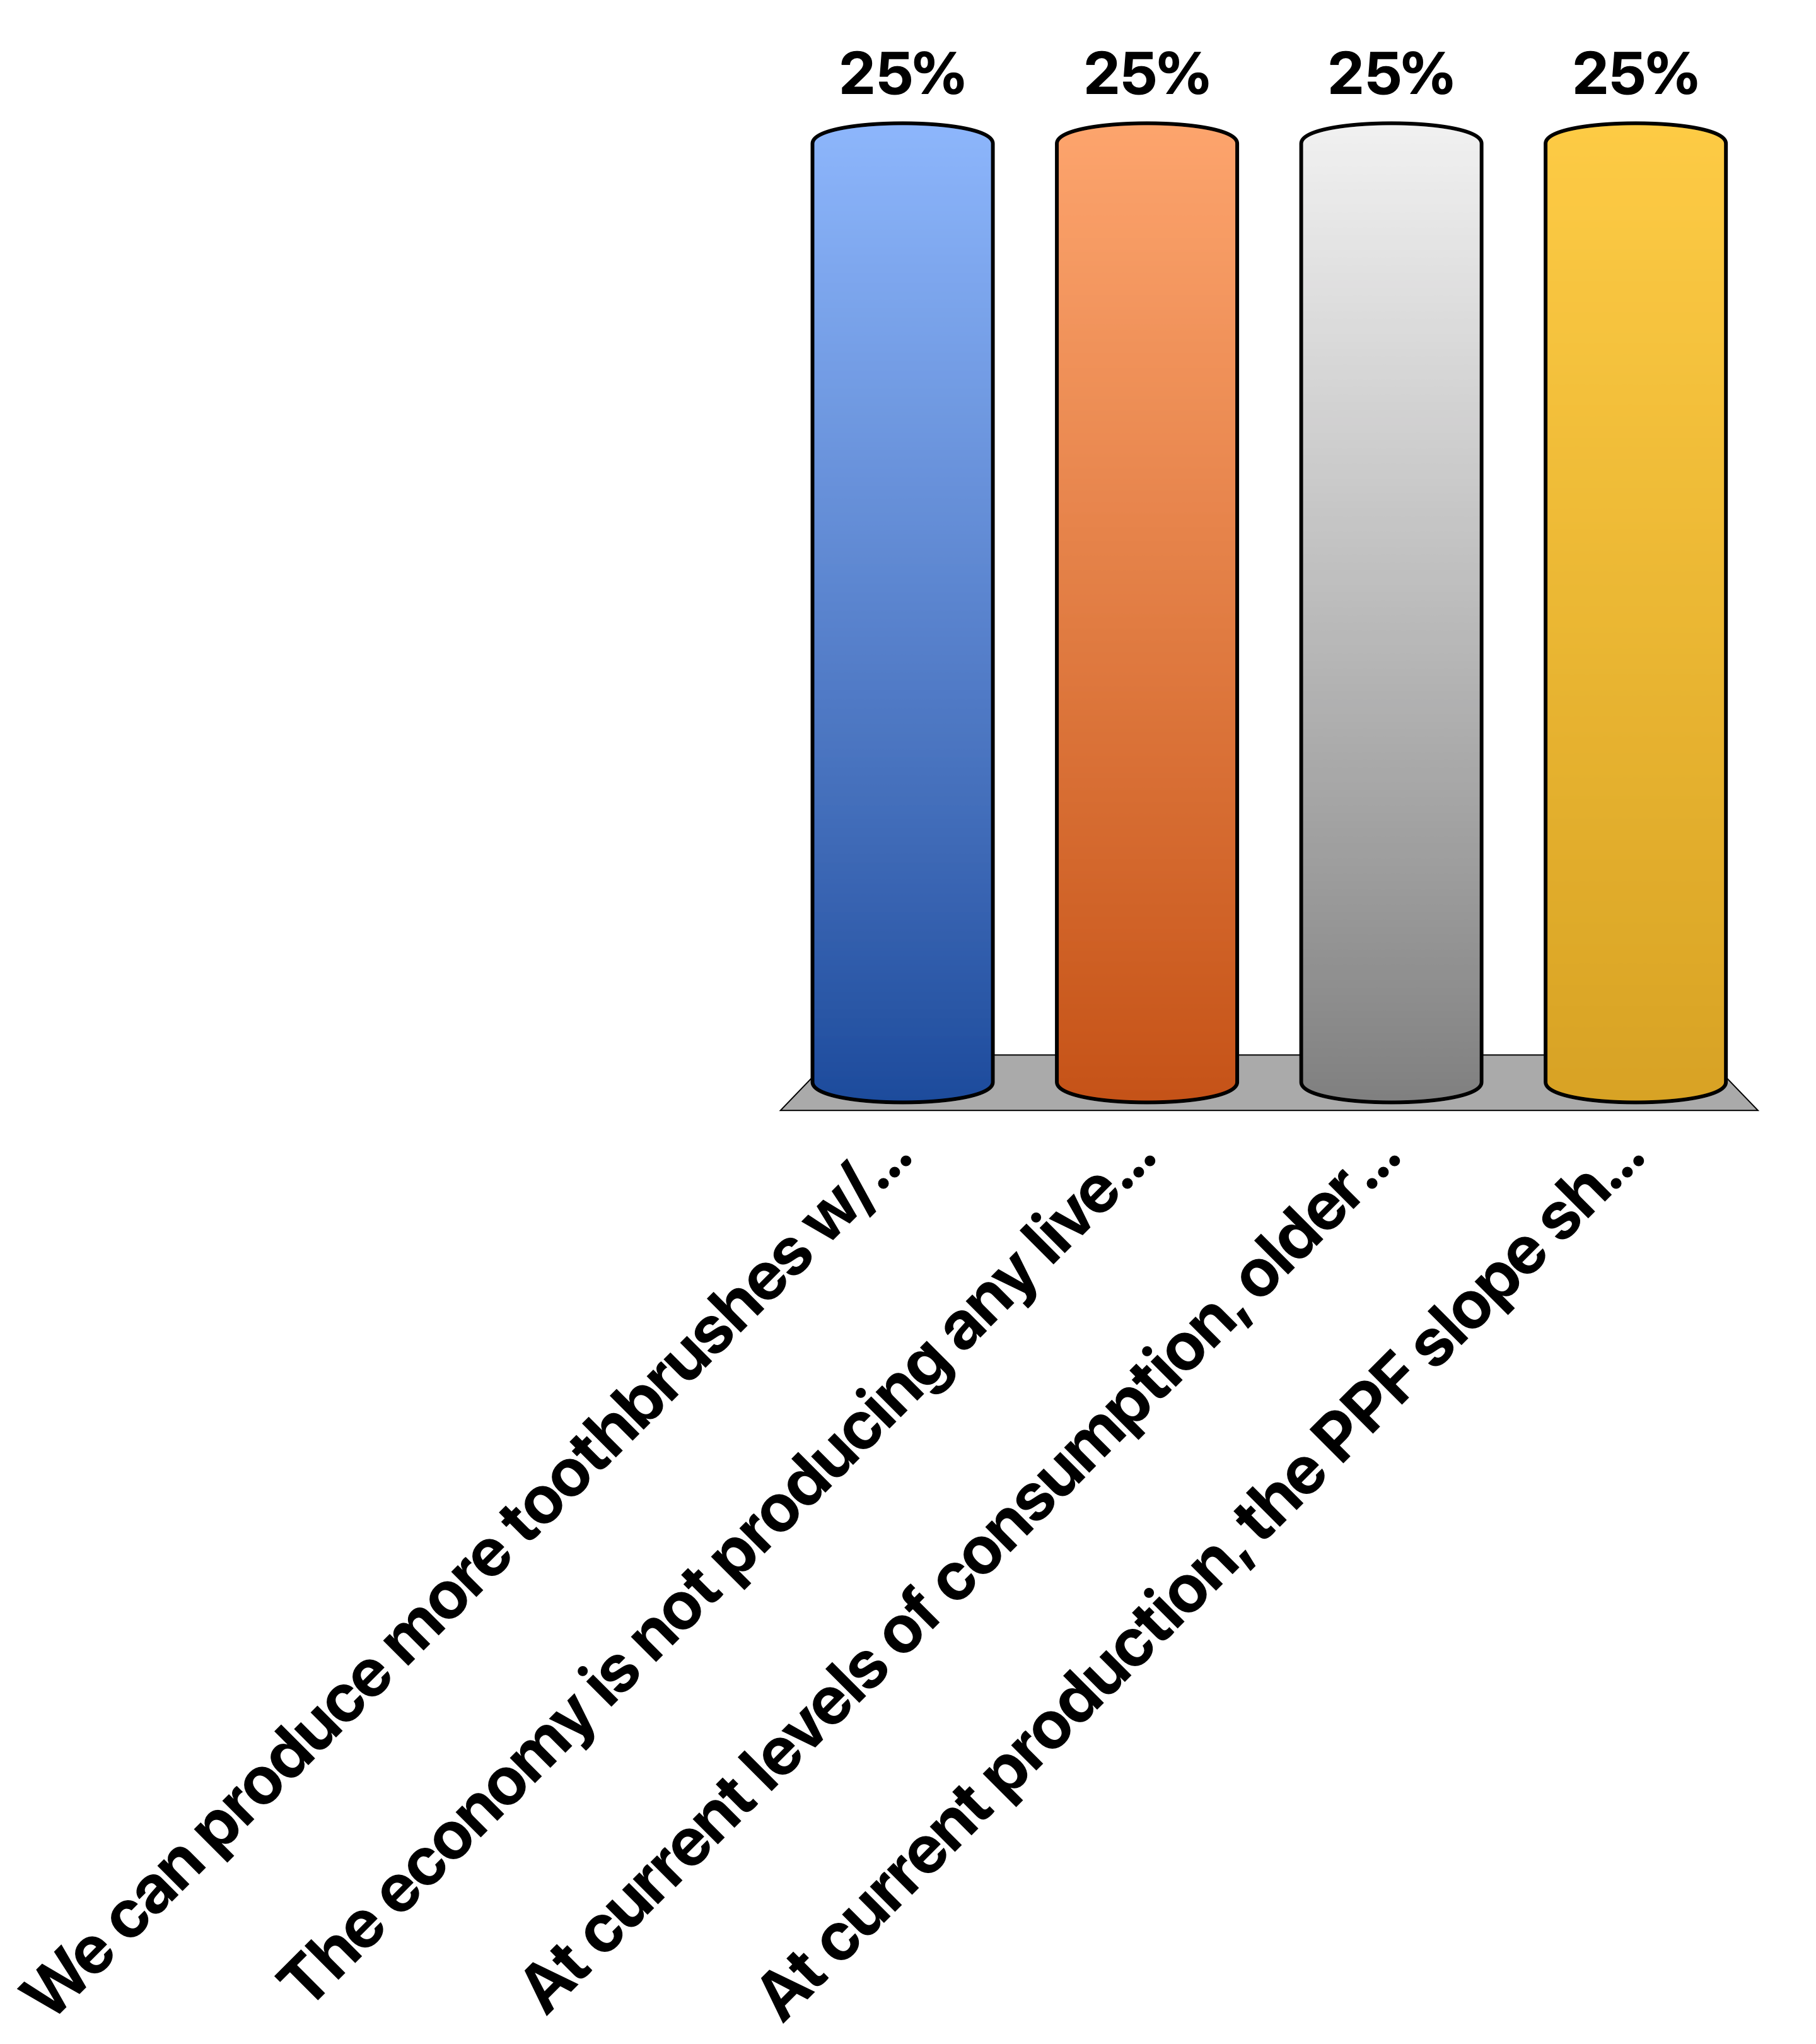
Choose one or all that are correct. The following situation(s) or condition(s) imply the economy has NOT attained a Pareto efficient outcome.
We can produce more toothbrushes w/o producing less toothpaste, but this requires us to produce less food; consumers value all 3 goods
The economy is not producing any liverwurst; however, liverwurst does not enter into any consumer’s utility function.
At current levels of consumption, older people are willing to give up 2 toothbrushes for 1 toothpaste, while younger people are willing to trade these off 1-for-1; both groups have a positive amount of each.
At current production, the PPF slope shows we can produce 1 fewer tube of toothpaste & thus produce 2 more toothbrushes. All consumers have a MRS of 1 between these, & all consume a + amount of both.
1:30

Slide 7
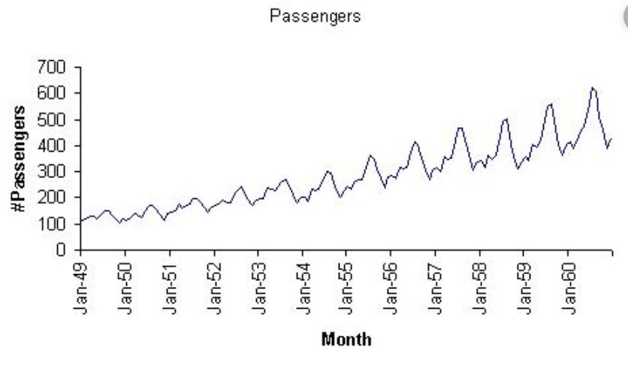
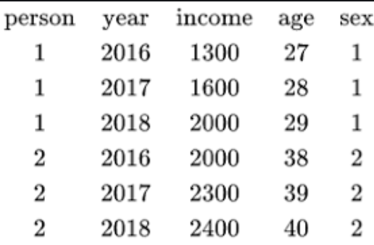
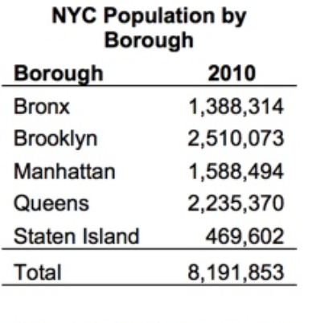
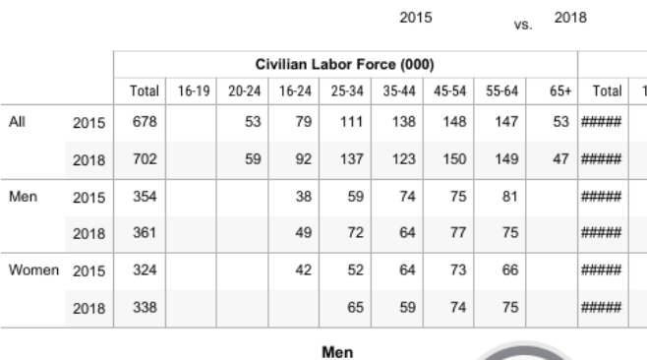
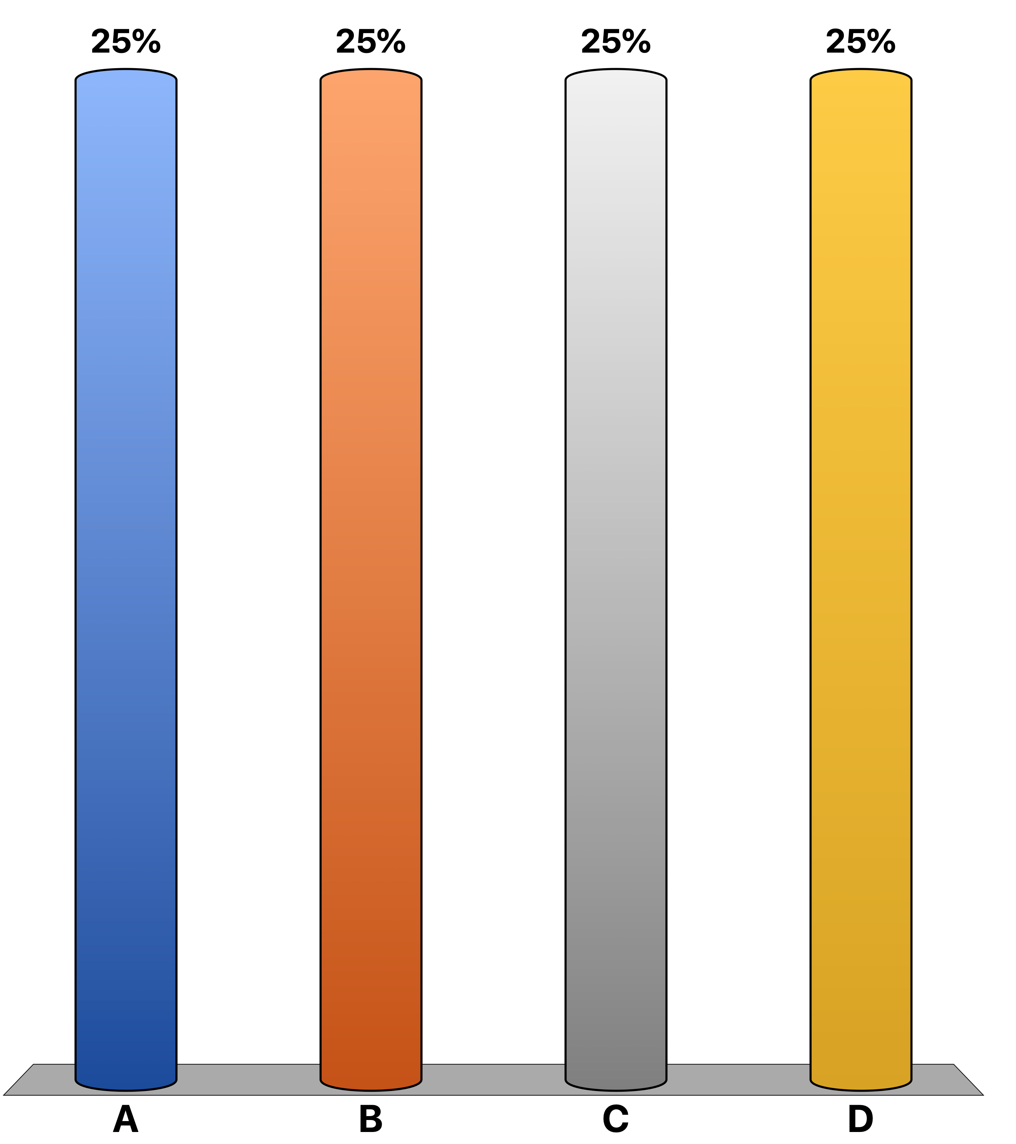
Which of the following depict PANEL MICRO-DATA (clockwise A,B,C,D; choose ALL correct)
1:20
A
B
C
D

Slide 8
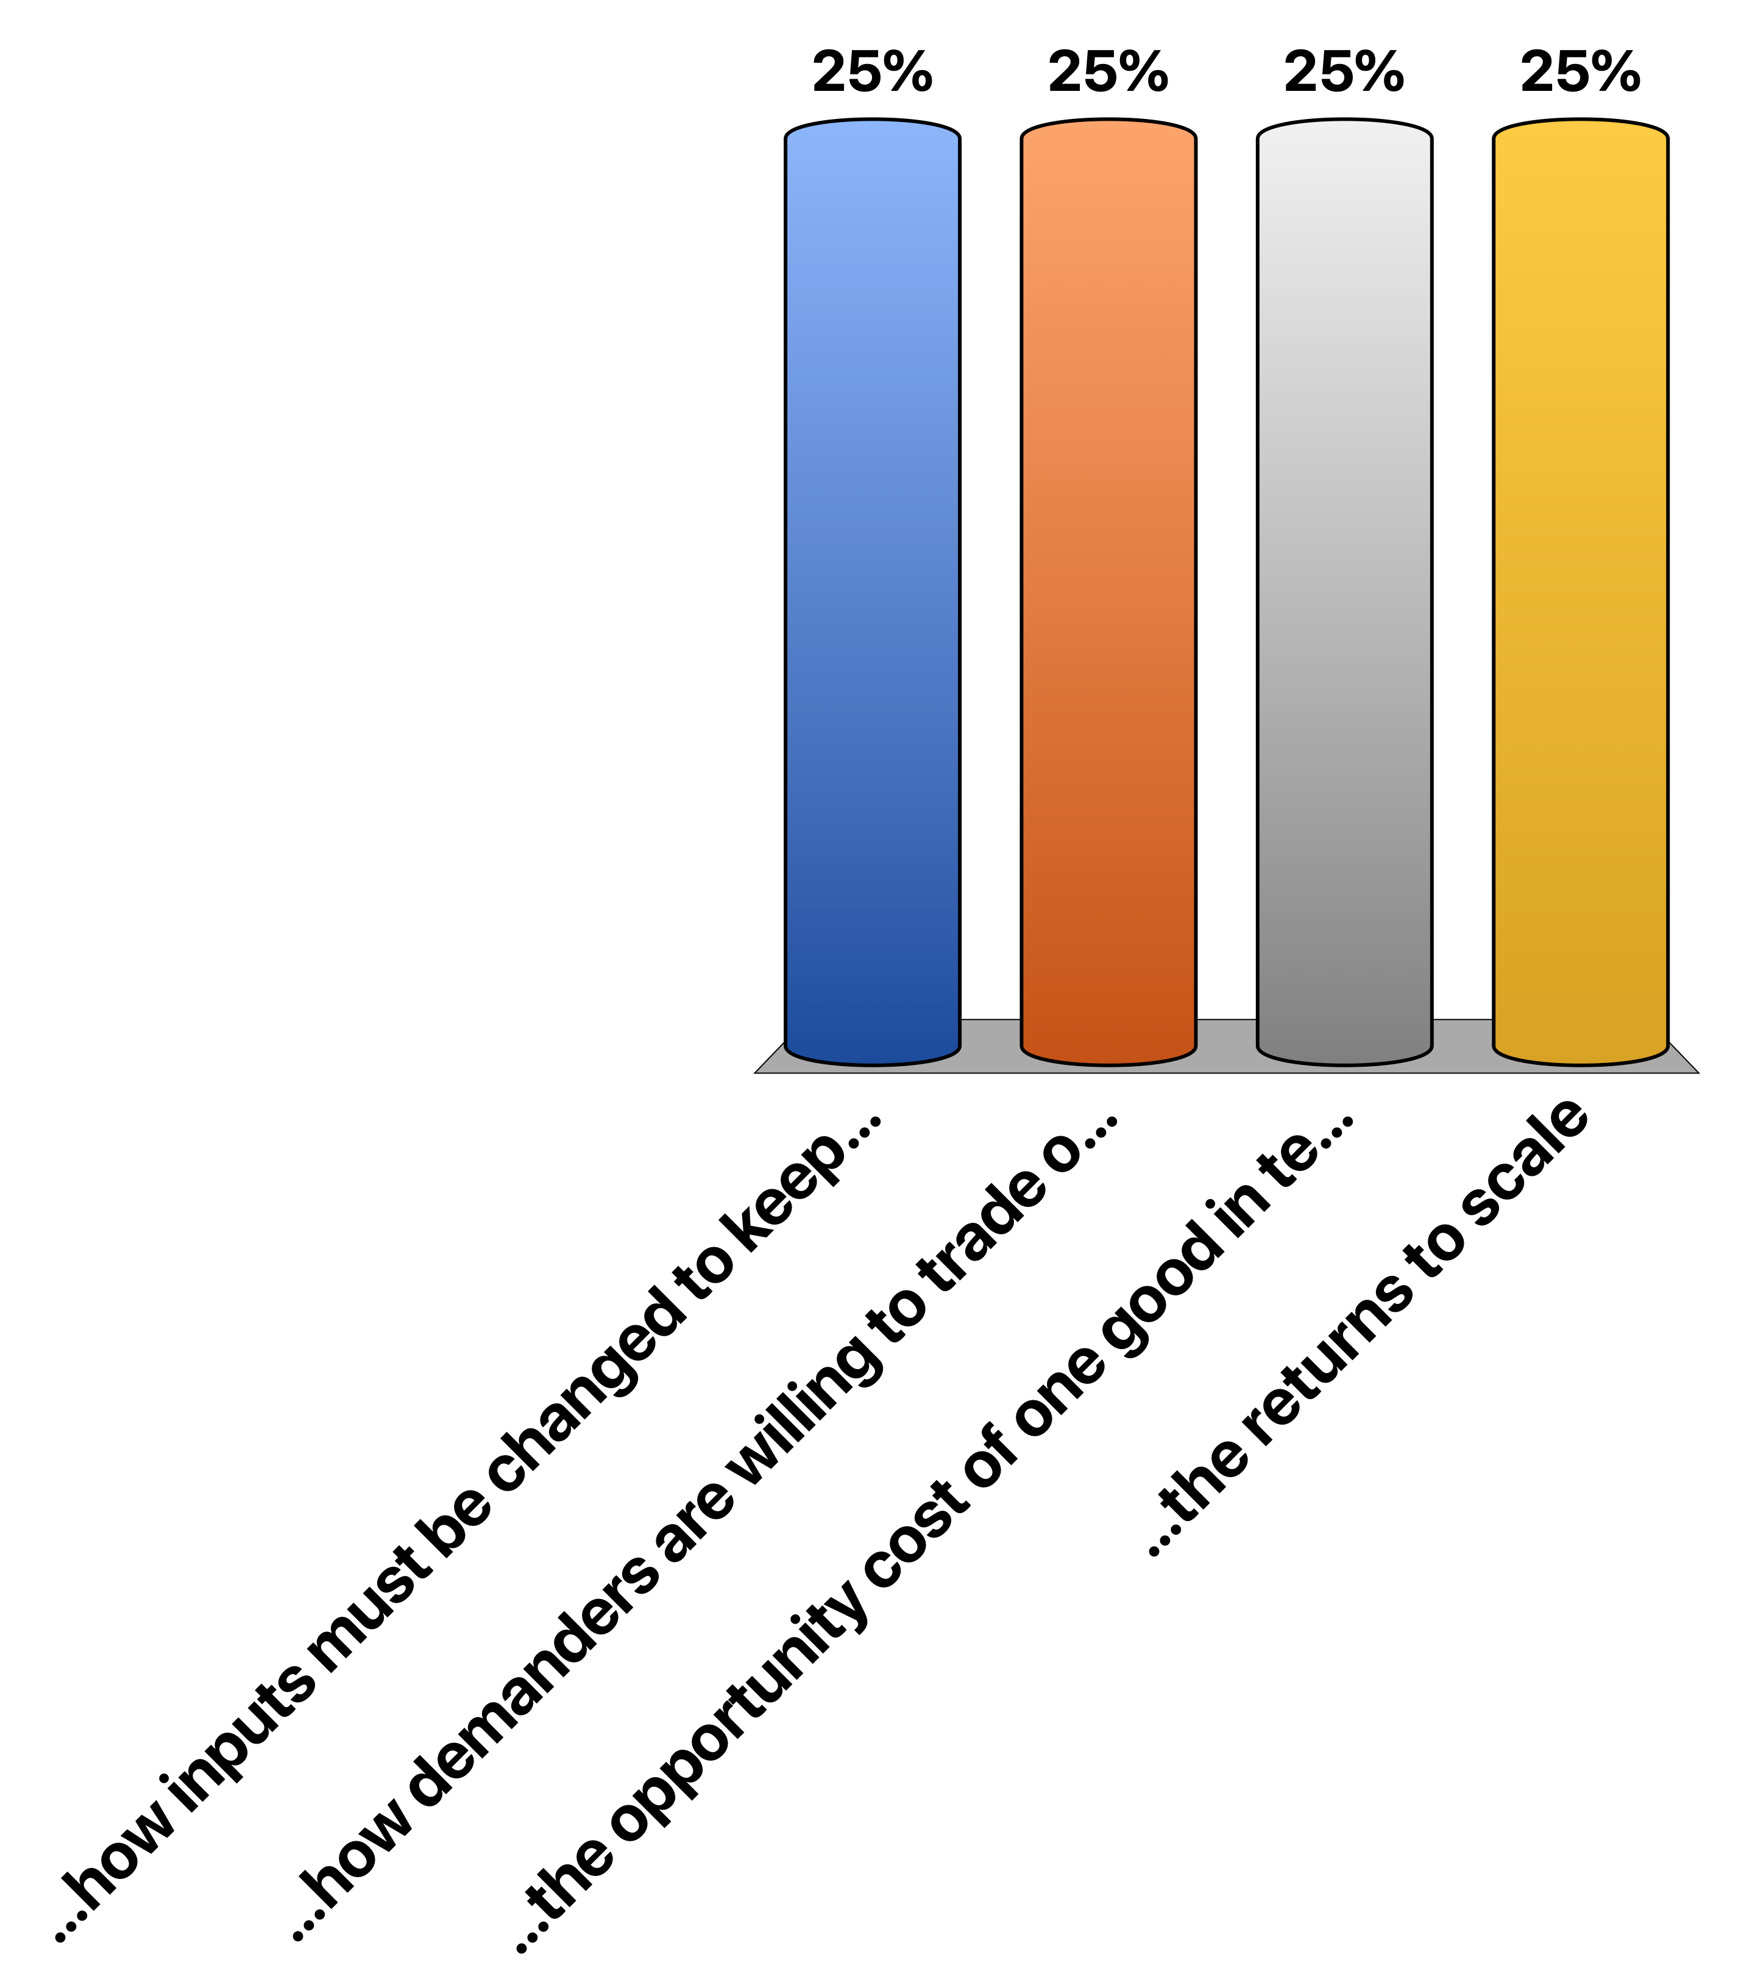
The slope of the production possibility frontier shows (choose ONE)
…how inputs must be changed to keep them fully employed.
…how demanders are willing to trade one good for another.
…the opportunity cost of one good in terms of the other
…the returns to scale
:35

Slide 9
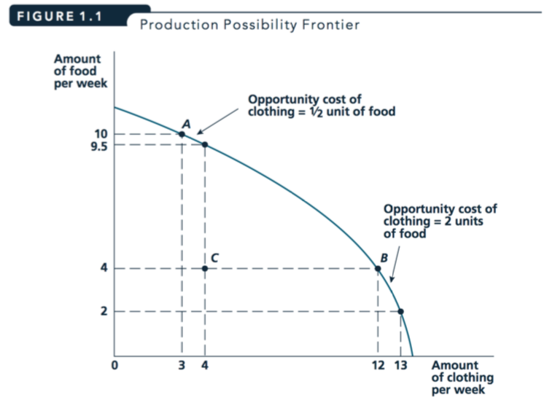

Slide 10
Challenge question

Slide 11

I observe the prices and total quantities of coffee traded in a market from the years 1990-2010. I plot a ‘minimum distance’ line through these points This line is a reasonable estimate… (choose all that are correct):
…of the supply curve even if the supply and demand curve were both shifting during this period
…of the demand curve even if the supply and demand curve were both shifting during this period
…of the supply curve for coffee if this represents a period in which the supply curve was constant and the demand curve was shifting
…of the demand curve if there is only a single coffee supplier, and this firm randomly chose prices each year, during a period in which the demand curve was constant
Notes:
DOUBLE MARK!

Slide 12
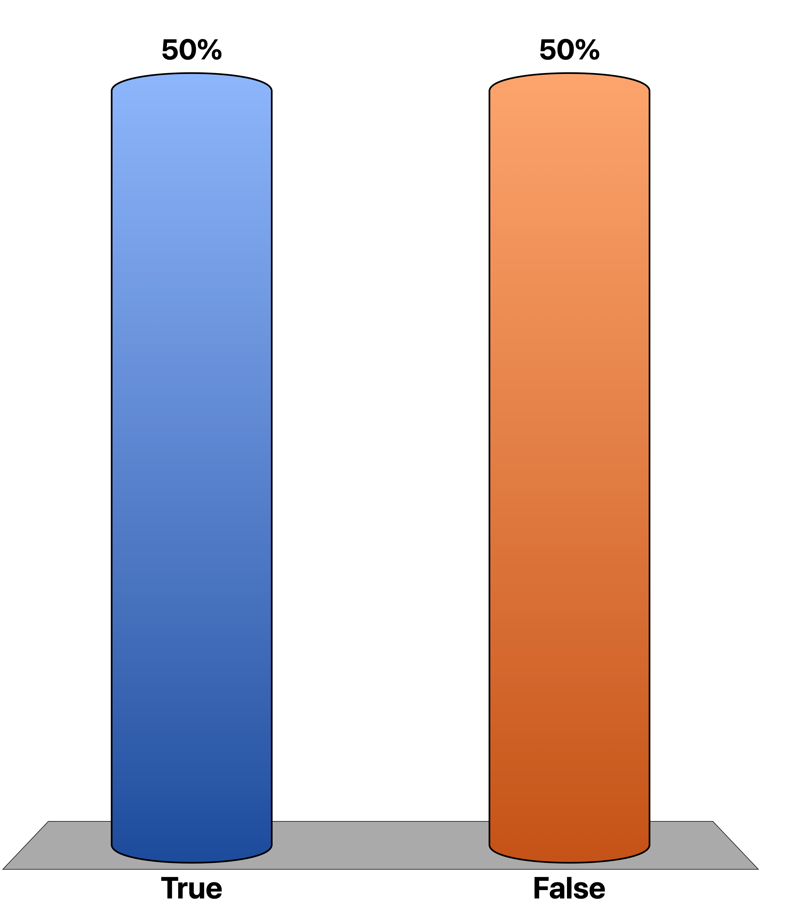
True or false: If people who attended university earn more than those who did not, this proves that university makes people more productive.
True
False
Notes:
Consider, what sort of data would you need to have evidence on this?

Slide 13
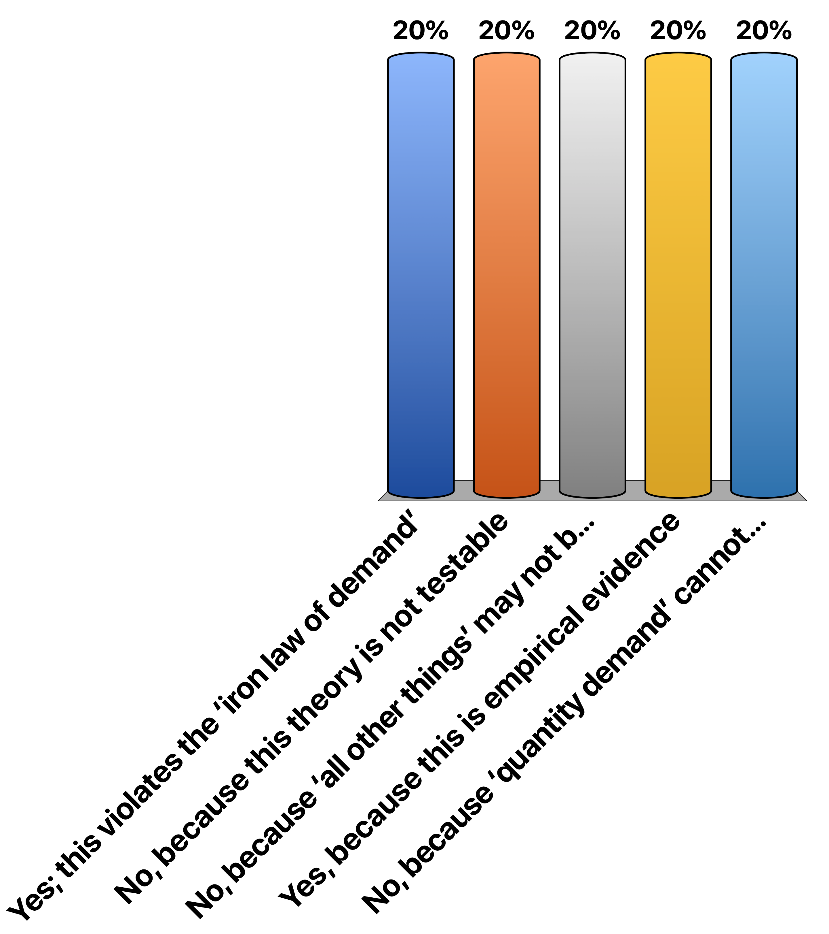
Gasoline sells for £4.00 per gallon this year, and it sold for £3.00 per gallon last year. But consumers bought more gasoline this year than they did last year. Does this contradict the economic theory that people tend to buy less when the price rises? Choose the (one) most correct response below:
Yes; this violates the ‘iron law of demand’
No, because this theory is not testable
No, because ‘all other things’ may not be equal from year to year
Yes, because this is empirical evidence
No, because ‘quantity demand’ cannot be compared from year to year.
:90

Slide 14
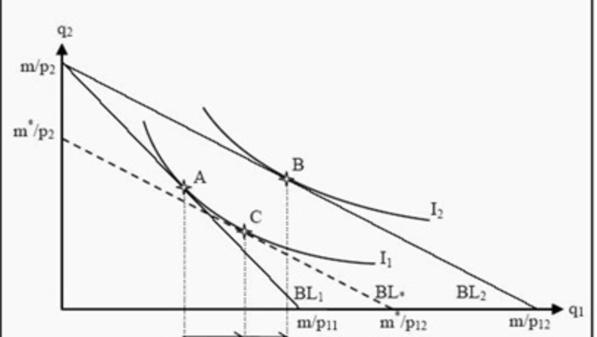

In the diagram below, good 1 (horizontal axis) is, in this range (choose all are correct)
Good 1 is Normal
Good 1 is Inferior
Good 1 Giffen
Good 2 is a (gross) complement for good 1
Good 2 is a (gross) substitute for good 1
1:20

Slide 15
Challenge question

Slide 16
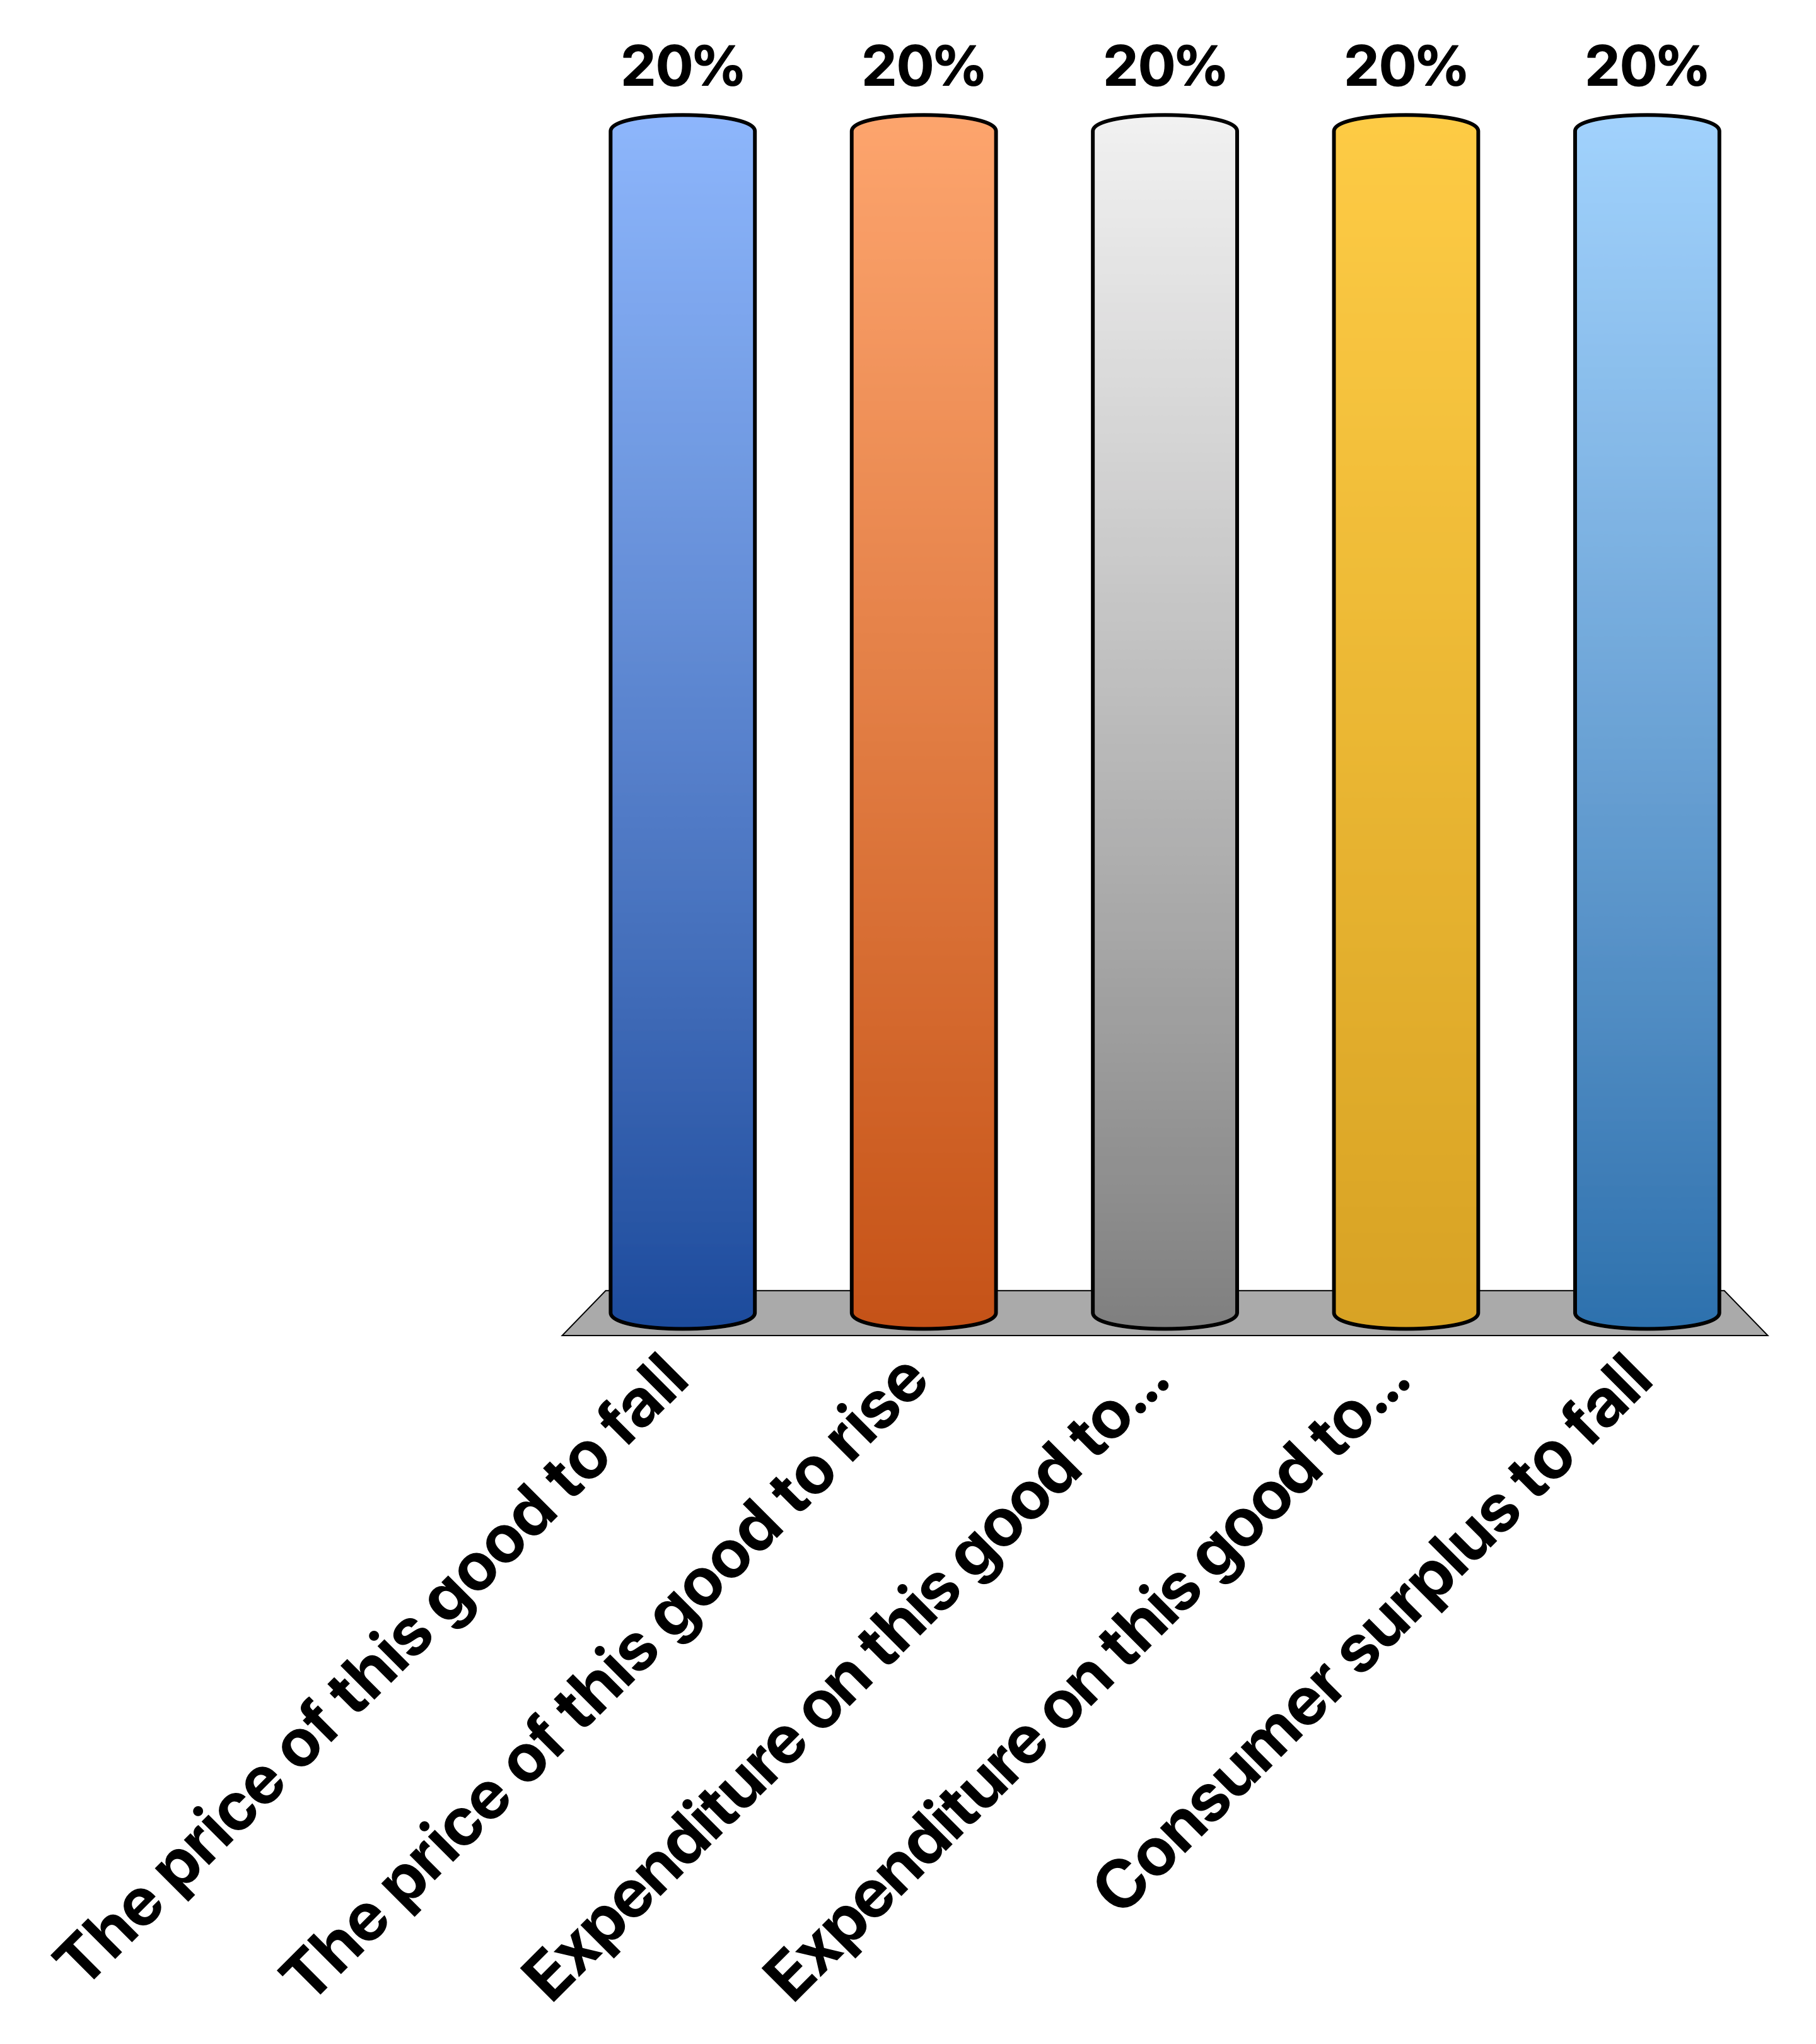
(Choose all that are correct) If market demand for a good is price-elastic at current prices, a reduction in the variable cost of production for all firms, under perfect competition, in the short run, will cause…
The price of this good to fall
The price of this good to rise
Expenditure on this good to rise
Expenditure on this good to fall
Consumer surplus to fall
70
Notes:
Reduction in costs → firms produce more at each price --> supply curve shifts out → price falls
As it’s price-elastic quantity demand increases by a greater percentage than the fall in price, thus expenditure will rise
Consumer surplus will rise, not fall.

Slide 17
Challenge question

Slide 18

Suppose the production function for good q is given by q(K,L) = K^{1/2}L^{1/2} where K and L are capital and labour inputs. Which of the following statements are true? (Choose all…) Recall: the partial derivative of a function f(x,y) = cxªy^{b} with respect to x is acx^{a-1}y^{b} (where a is not -1)
The function exhibits constant returns to scale
The function exhibits increasing returns to scale
The function exhibits decreasing returns to scale
The function exhibits diminishing marginal productivity for each input (holding the other input constant).
The function exhibits increasing marginal productivity for each input (holding the other input constant)
:90
Notes:
CRS: q(aK, aL) = (aK)^0.5*(aL)^0.5 = a^0.5*a^0.5*K^0.5L^0.5 = a q(K,L)
Partial derivatives wrt K is ½*K^{-1/2}L^{1/2} . This decreases in K … we see the slope of this slope (second derivative) will be negv … and symmetrically for L.

Slide 19

Which of the following are most reasonably considered public goods? (choose all that are correct)
A pint of beer in a pub
A flood control system protecting the city from flooding
Basic knowledge generated from a scientific discovery
Physical therapy provided by the NHS
Housing

Slide 20
Gasoline sells for £4.00 per gallon this year, and it sold for £3.00 per gallon last year. But consumers bought more gasoline this year than they did last year. Does this contradict the economic theory that people tend to buy less when the price rises? Choose the (one) most correct response below:
Yes; this violates the ‘iron law of demand’
No, because this theory is not testable
No, because ‘all other things’ may not be equal from year to year
Yes, because this is empirical evidence
No, because ‘quantity demand’ cannot be compared from year to year.

Slide 21
Challenge question

Slide 22

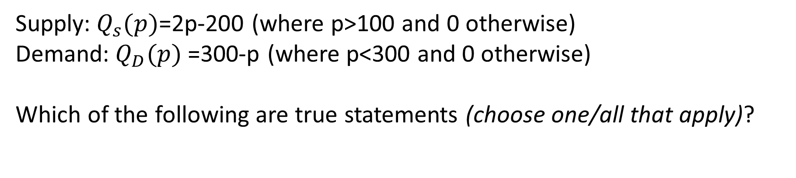
Supply:$Q_{s}(p)$=2p-200 (where p>100 and 0 otherwise) Demand:$Q_{D}(p)$=300-p (where p<300 and 0 otherwise) Which of the following are true statements (choose one/all that apply)?
At p=0 the excess demand is 300
For any prices above 100 and below 300, a positive quantity will be exchanged
If the government imposed a price of 500/3 (166 and 2/3) there would be a shortage
If the government imposed a price of 500/3 (166 and 2/3) there would be a surplus
Notes:
Correct: At p=0 the excess demand is 300. Correct: For any prices above 100 and below 300, a positive quantity will be exchanged. The other answers are incorrect -- if the government imposed this price it has 'guessed right' -- this is the equilibrium price, so no shortage nor surplus. In general this might be unlikely to occur with a government-imposed price.

Slide 23

Under standard assumptions, indifference curves: (Choose one or all that are correct.)
never intersect one another
represent the set of affordable consumption bundles
are always upwards sloping
are always flat
connect the sets of points that maximise utility

Slide 24

We can represent a person's preferences with a continuous utility function even if (choose all that apply)
their preferences violate transitivity
they prefer more of one good over less of that good
they are unemployed
they cannot state a preference nor make a choice between many categories of goods
They dislike chicken

Slide 25
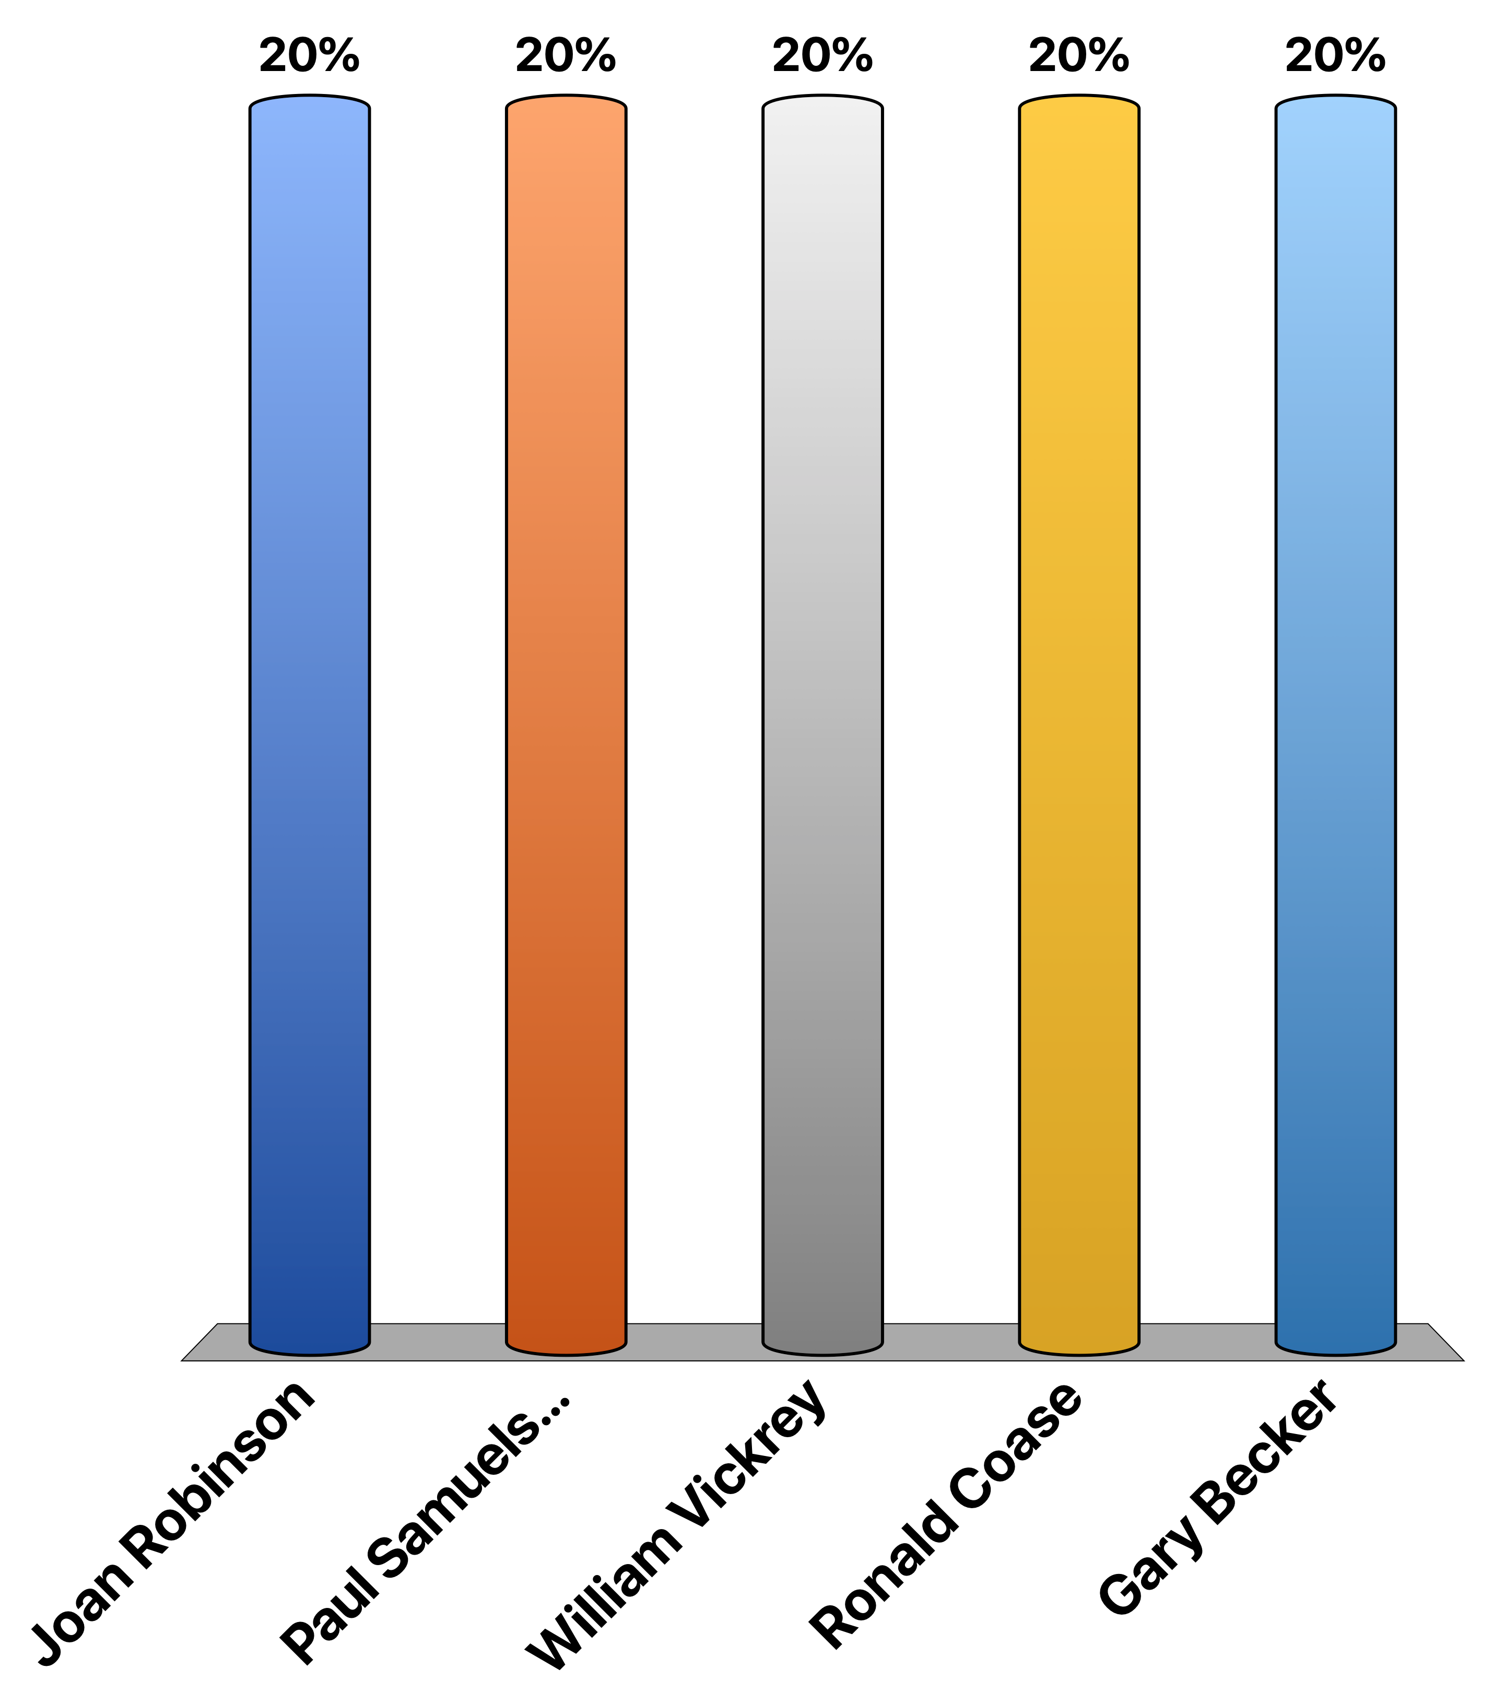
Who is this guy?
Joan Robinson
Paul Samuelson
William Vickrey
Ronald Coase
Gary Becker

Slide 26

Samuelson memorial winners board - 2019
We salute the highest scorers in the pre-midterm championship:
RJ27 9.33 GOLD
Gbolahan Adetunji 9 SILVER
Dark lord 8.33 BRONZE
minwin 8.66 Honourable mention
Alex Papanicolaou 8.66 Honourable mention

